Slide 1
K-Nearest Neighbour Classification
Back Ground
Slides adapted from various web sources with grateful acknowledgement of the many others who made their course materials freely available online.

Slide 2
Supervised vs. Unsupervised
Labeled Data
Unlabeled Data
X1 | X2 | Class
10 | 100 | Square
4 | 2 | Root
X1 | X2
10 | 100
4 | 2

Slide 3
Few Supervised Algorithms
K Nearest Neighbors (kNN)
Naïve-Bayes
Decision trees
Many others (support vector machines, neural networks, genetic algorithms, etc)

Slide 4
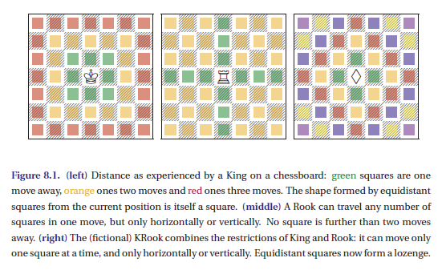
Distance

Slide 5
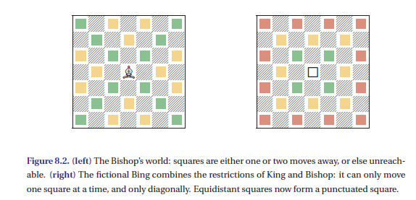
Distance

Slide 6
Distances
Distance are used to measure similarity
There are many ways to measure the distance s between two instances
Distance
Euclidean Distance
Minkowski distance
Hamming Distance
Mahalanobis Distance

Slide 7
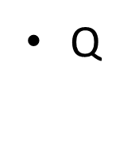
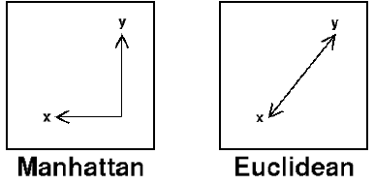

Distances
Manhattan Distance
|X1-X2| + |Y1-Y2|
Euclidean Distance
$\sqrt{\left(x1−x2\right)2}+√\left(y1−y2\right)$²

Slide 8
Properties of Distance
Dist (x,y) >= 0
Dist (x,y) = Dist (y,x) are Symmetric
Detours can not Shorten Distance
Dist(x,z) <= Dist(x,y) + Dist (y,z)
z
X
X
y
y
z

Slide 9
Distances Measure
Distance Measure – What does it mean “Similar"?
Minkowski Distance
Norm:
Chebyshew Distance
Mahalanobis distance:
d(x , y) = |x – y|^{T}S_{xy}⁻¹|x – y|

Slide 10
Nearest Neighbor

Slide 11
Nearest Neighbor Classifiers
Basic idea:
If it walks like a duck, quacks like a duck, then it’s probably a duck
Compute Distance
Test Record
Training Records
Choose k of the “nearest” records

Slide 12
Definition of Nearest Neighbor
K-nearest neighbors of a record x are data points that have the k smallest distance to x

Slide 13
Nearest Neighbor Search
Given: a set P of n points in R^{d}
Goal: a data structure, which given a query point q, finds the nearest neighbor p of q in P
p
q

Slide 14
K - Nearest Neighbors
For a given instance T, get the top k dataset instances that are “nearest” to T
Select a reasonable distance measure
Inspect the category of these k instances, choose the category C that represent the most instances
Conclude that T belongs to category C

Slide 15
K - Nearest Neighbors
KNN algorithm is one of the simplest classification algorithm
non-parametric
it does not make any assumptions on the underlying data distribution
lazy learning algorithm.
there is no explicit training phase or it is very minimal.
also means that the training phase is pretty fast.
Lack of generalization means that KNN keeps all the training data.
Its purpose is to use a database in which the data points are separated into several classes to predict the classification of a new sample point.

Slide 16
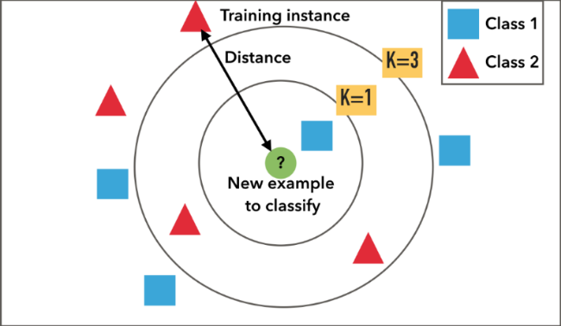
K - Nearest Neighbors
KNN Algorithm is based on feature similarity
How closely out-of-sample features resemble our training set determines how we classify a given data point

Slide 17
Example 1
Determining decision on scholarship application based on the following features:
Household income (annual income in millions of pesos)
Number of siblings in family
High school grade (on a scale of 1.0 – 5.0)
Intuition (reflected on data set): award scholarships to high-performers and to those with financial need

Slide 18
Example revisited
Suppose household income was instead indicated in thousands of rupees per month and that grades are given on a 70-100 scale
Note different results produced by kNN algorithm on the same dataset

Slide 19
Nearest-Neighbor Classifiers: Issues
The value of k, the number of nearest neighbors to retrieve
Choice of Distance Metric to compute distance between records
Computational complexity
Size of training set
Dimension of data

Slide 20
Value of K
Choosing the value of k:
If k is too small, sensitive to noise points
If k is too large, neighborhood may include points from other classes
Rule of thumb:
K = sqrt(N)
N: number of training points

Slide 21
Non-numeric data
Feature values are not always numbers
Example
Boolean values: Yes or no, presence or absence of an attribute
Categories: Colors, educational attainment, gender
How do these values factor into the computation of distance?

Slide 22
Dealing with non-numeric data
Boolean values => convert to 0 or 1
Applies to yes-no/presence-absence attributes
Non-binary characterizations
Use natural progression when applicable; e.g., educational attainment: GS, HS, College, MS, PHD => 1,2,3,4,5
Assign arbitrary numbers but be careful about distances; e.g., color: red, yellow, blue => 1,2,3
How about unavailable data? (0 value not always the answer)

Slide 23
K-NN
(K)-NN: Reduce complexity by having a threshold on the majority. We could restrict the associations through (K)-NN. K=5

Slide 24
K-NN
Select 5 Nearest Neighbors
as Value of K=5 by taking their
Euclidean Distances

Slide 25
K-NN
Decide if majority of Instances over a given value of K Here, K=5.

Slide 26
Example
Points | X1 (Acid Durability ) | X2(strength) | Y=Classification
P1 | 7 | 7 | BAD
P2 | 7 | 4 | BAD
P3 | 3 | 4 | GOOD
P4 | 1 | 4 | GOOD

Slide 27
KNN Example
Points | X1(Acid Durability) | X2(Strength) | Y(Classification)
P1 | 7 | 7 | BAD
P2 | 7 | 4 | BAD
P3 | 3 | 4 | GOOD
P4 | 1 | 4 | GOOD
P5 | 3 | 7 | ?

Slide 28
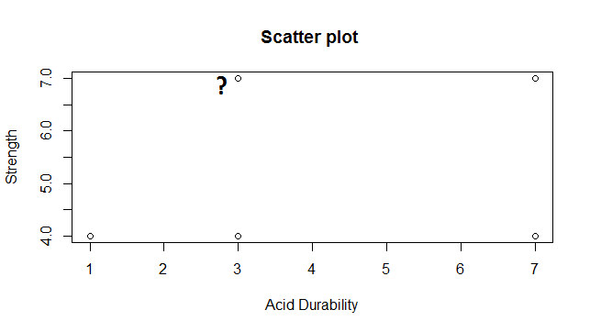
Scatter Plot

Slide 29
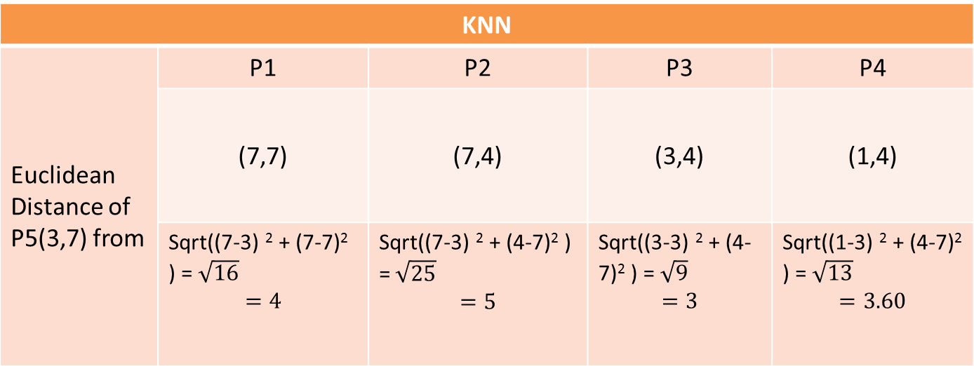
Euclidean Distance From Each Point
KNN
Euclidean Distance of P5(3,7) from | P1 | P2 | P3 | P4
 | (7,7) | (7,4) | (3,4) | (1,4)
 | Sqrt((7-3) ² + (7-7)² ) =$\sqrt{16}$ $$=4$$ | Sqrt((7-3) ² + (4-7)² ) =$\sqrt{25}$ $$=5$$ | Sqrt((3-3) ² + (4-7)² ) =$\sqrt{9}$ $$=3$$ | Sqrt((1-3) ² + (4-7)² ) =$\sqrt{13}$ $$=3.60$$

Slide 30
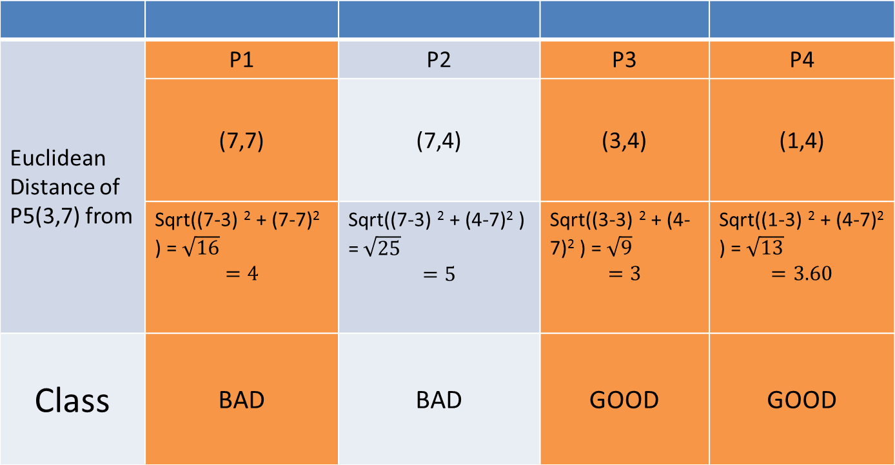
3 Nearest NeighBour
Euclidean Distance of P5(3,7) from | P1 | P2 | P3 | P4
 | (7,7) | (7,4) | (3,4) | (1,4)
 | Sqrt((7-3) ² + (7-7)² ) =$\sqrt{16}$ $$=4$$ | Sqrt((7-3) ² + (4-7)² ) =$\sqrt{25}$ $$=5$$ | Sqrt((3-3) ² + (4-7)² ) =$\sqrt{9}$ $$=3$$ | Sqrt((1-3) ² + (4-7)² ) =$\sqrt{13}$ $$=3.60$$
Class | BAD | BAD | GOOD | GOOD

Slide 31
KNN Classification
Points | X1(Durability) | X2(Strength) | Y(Classification)
P1 | 7 | 7 | BAD
P2 | 7 | 4 | BAD
P3 | 3 | 4 | GOOD
P4 | 1 | 4 | GOOD
P5 | 3 | 7 | GOOD

Slide 32
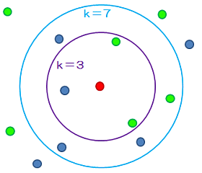
Different Values of K

Slide 33
References
Machine Learning : The Art and Science of Algorithms that Make Sense of Data By Peter Flach
A presentation on KNN Algorithm : West Virginia University , Published on May 22, 2015
https://web.iitd.ac.in/~bspanda/KNN%20presentation.pdf

